Slide 1
Campus Update
December 8, 2021

Slide 2

Agenda
Fall Semester Highlights
Covid-19 Update
Strategic Planning Update
Financial Update
Restorative Justice Commission Update

Slide 3
Fall Semester Highlights
Marcelo Suárez-Orozco
Chancellor

Slide 4

A Few Fall Semester Highlights
UMass Boston received a historic $15 million donation to endow our nursing program, now renamed the Robert and Donna Manning College of Nursing and Health Sciences.
22 new externally sponsored grants and contracts totaling $11.5 million during the first quarter of the year (July-September).
Unveiled a new mural by Robert Peters, an artist and member of the Mashpee Wampanoag Tribe, in the residence hall to pay homage to and recognize that UMass Boston is still Indigenous space.
UMass Boston Celebrated First Generation Students with First Gen Week recognizing Beacons who are the first in their families to attend a four-year college or university. Currently 60% of our students identify as first generation.
4

Slide 5
A Few Fall Semester Highlights
Hosted 2nd annual Black Lives Matter Day highlighting the theme of “empowerment through collective leadership.” Diverse workshops and productive discussions were led by an extraordinary group of Boston-based Black leaders and activists.
Every fall athletics team qualified for their respective conference tournaments, with three teams earning a top-2 seed.
Volleyball team won the program’s 10th Little East Conference Tournament Championship.
Cross country runner Jimmy Cannon became the first runner in UMass Boston history to win the Little East Conference Championship meet.
Yesterday, I represented UMass Boston on the White House virtual roundtable on Operation Allies, the whole-of-America effort to resettle our Afghan allies. The Roundtable was led by the Honorable Jack Markell (former Governor of Delaware) and Secretary of Education Miguel Cardona.
5

Slide 6
COVID-19 Update
Garrett Smith
Deputy Chancellor

Slide 7
Safety protocols this semester enabled a safe return to in person operations
1
4
Required COVID vaccinations
Contact tracing and testing
Limited religious and medical exemptions
99.4% of students vaccinated
99.2% of employees vaccinated
5
Surveillance testing
2
Unvaccinated individuals
Higher risk populations
Indoor mask wearing
6
Required indoors
Required in crowded outdoor settings
Emphasis on hygiene and health
3
Encourage flu and COVID booster shots
Encourage hand washing, hand sanitizer
Symptom monitoring
7
Daily health check
If you have symptoms, STAY HOME & TEST!
Specific efforts on HVAC, dining, events, travel, and other areas

Slide 8
We are closely monitoring the situation, including emerging data and health guidance
Significant increase in Delta cases locally and nationally
Emergence of Omicron
Increase in known positives amongst our campus population
Weekly known positives at UMB (fall semester)
Known positives by category
Note: Campus data available at www.umb.edu/coronavirus/dashboard
8

Slide 9
Our positivity rate continues to be low with no known hospitalizations
Weekly positivity rate at UMB (fall semester)
Known hospitalizations
(fall semester)
0
UMB positivity rate has remained relatively low (state = 4.86%)
Vast majority of positives are a result of symptomatic testing
Very few (only a handful all semester) are a result of asymptomatic surveillance testing
No known hospitalizations
Note: Campus data available at www.umb.edu/coronavirus/dashboard; statewide positivity rate of 4.86% is a 7 day average as of 12/6

Slide 10
We must remain vigilant against this virus
Our safety protocols seem to be working to keep our campus safe
There is no cause for alarm in the recent positive cases we are seeing
We will continue to monitor the data and public health guidelines
Our protocols for the spring are likely to look much the same as the fall

Slide 11
Finally…
If you are eligible,
please get your booster shot!!!
Vaccination remains the most effective layer of protection in fighting the virus.
The CDC and FDA have authorized all individuals over the age of 18 to receive the booster shot.
We strongly encourage all members of our community to get a booster shot, once eligible (6 months after 2 dose vaccine or 2 months after 1 dose vaccine). Nearly 90% of our employees are already eligible.
University Health Services has vaccination appointments available each week and is working to add more.

Slide 12
Strategic Planning Update
Joseph B. Berger
Provost and Vice Chancellor for Academic Affairs

Slide 13
Strategic Planning Timeline
Phase 0
Pre-Planning / Launch
Phase 1
Input and Analysis
Phase 2
Recommendation development
Phase 3
Plan development
Phase 4
Implementation
Launch
Summer-Sep
Oct - Dec
Jan - Mar
Apr - May
Sep -
Process design
Nominations
Charge committees
Launch
Mission & Vision Committee
Academic Master Planning
Initial recommendations
3. Enrollment Planning Committee
4. Student Success Committee
5. Student Life Committee
6. Services and Responsiveness Committee
7. Community Engagement Committee
All committee recommendations
Synthesize, prune, prioritize
Share draft plan and refine
Plan finalized
Frequent opportunities for stakeholder input and feedback
Physical Master Planning
Pre-planning
Campus Master Planning
13

Slide 14
Grand Scholarly Challenges – Preliminary Themes
Major themes
Equitable Climate Adaptation | climate change / equity / justice / resilience / Boston / social determinants / disparities / racism / urban ocean waterfront / ecology
Health Disparities | cancer / hospitals / biotech / disparities / other universities / local workforce / urban / health-promoting / population aging
Data Science | problem solvers / disciplinary integration / multilingual / biotech / cancer
Democracy, Justice, and Collective Action | justice in pluralistic society / dialogue / preserving democracy / authoritarianism / restorative practices & participation / rhetoric / history
14

Slide 15
Grand Scholarly Challenges – Preliminary Themes
Major themes
University of the Future | Trans-disciplinarity / new pedagogies / reimagining teaching & scholarship / multicultural / immigrant-origin / languages / diverse / inclusive / reputation for teaching & learning / Boston / local partnerships / local-global
Urban Organizations | diversity / Commonwealth’s workforce / working students / public affairs / organizational understanding
Compounded Inequities | accumulation of disparities / racism / hunger / crisis / COVID, mental health, across the life course / multiple levels / ethnicity
Just & Resilient Boston | Boston / networked city / resilience / food access / free clinics / housing / experiential learning / rhetoric
Amplifying Voices | ethnic studies / community / equity / justice / dialogue / community engagement / inclusion / workforce diversity
15

Slide 16
We launched a number of Strategic Planning Committees
A. University Strategic Planning
Mission and Vision Committee
Academic Master Planning Committee
  Academic Program Development
  Research & Grand Scholarly Challenges
  Educational Effectiveness
  Faculty Support & Development
Strategic Enrollment Planning Committee
Student Success Committee
Student Life Committee
Services and Responsiveness Committee
  Human Resources Sub-Committee
Community Engagement Committee
Led by Provost Joe Berger
Led by Deputy Chancellor Garrett Smith
B. Campus Master Planning
Led by VC of A&F Kathleen Kirleis
8. Campus Master Planning Working Group
16

Slide 17
Financial Update
Kathleen Kirleis
Vice Chancellor Administration and Finance
17

Slide 18
FY21 Results
18

Slide 19
FY21 Results
FY21 Budget surplus driven by one-time Federal stimulus funds for COVID
  Recognition of Institutional aid for lost revenue (tuition & fee, auxiliaries) and COVID-related costs
    FY21: Revenue Recovery = $13,851,549
    FY21: Expense Recovery = $2,985,629
State Appropriation was not reduced as had been the original planning parameter (-10% /~$13.5M w/ fringe) and COLA
Tuition & Fee revenue was better than budgeted due to more in-state and better summer revenue than planned
Non-personnel expenses were low due to full-year remote work environment (utilities, shuttle & travel)
Personnel expenses were higher than budgeted due to need to accrue for COLA parameters provided by the state (2.5% base increase)
19
Notes:
HEERF Institutional FY21 Actual use:
FY21: Revenue Recovery = $13,851,549
FY21: Expense Recovery = $2,985,629

Slide 20
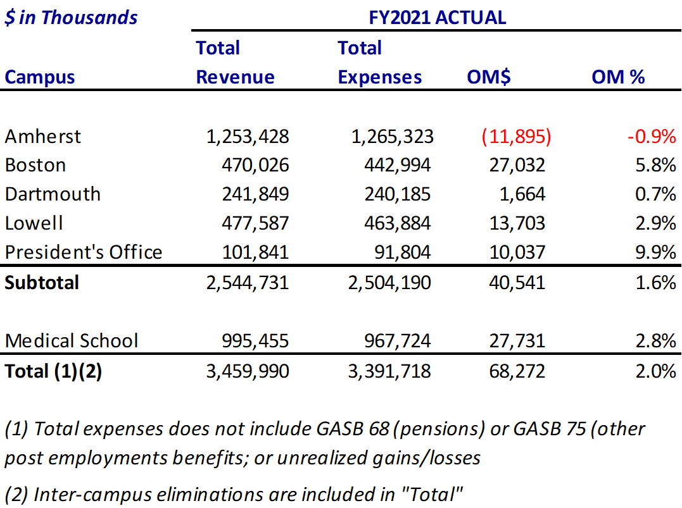
FY21 Overall UMass Financial Highlights
Impacts of COVID-19 continued to ripple through FY21 results
University operating revenue of $3.5 billion is flat as compared to last year; hard work to continue to balance FY21 after the pandemic impacts
Without one-time Federal Stimulus of $82.0 million ($54.9 million was for institutional aid including GEER), total FY21 revenue would have been below FY20 and FY19
20

Slide 21
FY22 Budget
21

Slide 22
Boston: Revenue & Expenses- June Board Meeting
FY22 Budget planned for a $6.5M surplus
  Assumed decline in net Tuition & Fee revenues due to COVID-driven drop in foreign student enrollment
  Salaries & Fringe and Non-Personnel expenses rise due to COLA and campus return from remote operations
  Full use of one-time Federal stimulus in Other Non-Operating revenue and Non-personnel and Scholarships & Fellowships expenses
22
Notes:
FY22 Budget projected a $6.5M surplus
Decline in net T&F revenues but use of remaining federal stimulus funds, set against sharply increasing salaries and NP expenses (FY21 and FY22 COLA’s and return to pre-COVID levels of business expenses.
S&F expenses are Fed Stim student funds?
4th and last year of new merit scholarship cohorts ~$3.5M gross base increase (netted by waiver expiring).
Waiting to see fall tuition

Slide 23
FY22 Budget Updates
The baseline budget adopted in July is being updated at points throughout the fiscal year, largely due to revenue uncertainties related to enrollment and COVID stimulus funds.
The campus is updating budget plans at the following milestones:
1.) Enrollment after add/drop – Updated in October
2) Finalization of spring semester plans – December/January
23

Slide 24
First Quarter Projection
No longer projecting a surplus
Reduced net tuition revenue due to:
  Fall enrollment (and effect on spring) $6.2M
  Increased restricted aid $1.4M
State Appropriation (COLA increase), Grant, Auxiliary and Other Non/Operating
Increased expenses in Salaries & Fringe (COLA increase) and Non-Personnel (Discharge of student AR with HEERF funds)
Planning to end the year in balance but still need to monitor certain key items:
  (+) State ARPA funds
  (-) Spring & Summer enrollment
24
Notes:
No longer projecting a surplus due to: (change, projection over budget)
Revenue: basically flat with budget
lower than budgeted net tuition revenue of -$7.6M
Increased state, grant, aux and other +$7.4M (State Appropriations is higher than budgeted due to the mental health funding and for fringe on the COLAs (2 years))
Expenses:
Increased salaries and fringe +$4.1M (for state parameter COLAs [FY21, 2.5%+1.5% one-time and FY22, 2.0%] and NTT over budget)
Increased NP +$2.4M (Why ???)
Stop at FY21

Slide 25
Federal Stimulus Funds
25

Slide 26
UMB State & Federal Stimulus Funds Awarded to Date https://www.umb.edu/the_university/covid_19_federal_assistance
NAME | AKA | STUDENT/MSI | INSTITUTION | TOTAL
Coronavirus Aid, Relief, and Economic Security Act | “CARES”, “HEERF I” | $6,141,512 | $6,092,326 | $12,233,838
Coronavirus Response and Relief Supplemental Appropriations | “CRRSAA”, “HEERF II” | 6,092,326 | 15,288,955 | 21,458,800
American Rescue Plan Act | “ARP”, “HEERF III” | 18,693,936 | 18,330,287 | 37,024,223
Governor's Emergency Education Relief Fund | “GEER” | NA | 889,635 | 889,635
TOTAL |  | $31,005,293 | $40,601,263 | $71,606,556
Excludes FEMA
HEERF = ”Higher Education Emergency Relief Fund”
26
Notes:
One-time funds to support during drop in revenues due to COVID 19
Student support aid/AR

Slide 27
Summary of HEERF (I, II, & III) Actions to Date
Student Portion:
Distributed $27.8M of direct student grants from March 2020 through 2021 YTD
  CARES/HEERF I -- $8.0M over 4 rounds
    Application-driven [avg 4,228 students /$486 per round]
  CRRSAA/HEERF II -- $5.8M in two phases
    Formula [10,000 students/$460]
    Application [1,650 students/$720]
  ARPA/HEERF III -- $14.0M
    Formula [15,583 students/$918]
Institutional Portion:
FY20 Actions:
  Accounted for $1.75M in Parking and Dining refunds, and Chromebooks, to students from CARES/HEERF II
  Transferred $1.85M from CARES Institutional to Student (part of distribution above)
FY21 Actions:
  Lost revenue recovery = $13,851,549
  Covid–related expense recovery = $2,985,629
FY22 Actions:
  Student accounts receivable balance discharges totaling $5,898,187.60 and affecting 1,684 students
  FY22: $117,112 in retention grants to students
27

Slide 28
Use of UMB Stimulus Funds to Date
NAME | STUDENT & MSI | STUDENT SPEND | INSTITUTION | INSTITUTION SPEND | TOTAL | TOTAL SPEND | REMAINING FUNDS
HEERF I | 6,141,512 | 7,992,215* | 6,092,326 | 4,241,623* | 12,233,838 | 12,234,191 | ($353)
HEERF II | 6,169,845 | 5,800,149 | 15,288,955 | 14,328,798 | 21,458,800 | 20,128,947 | $1,329,853
HEERF III | 18,693,936 | 14,303,900 | 18,330,287 | 6,286,422 | 37,024,223 | 20,590,322 | $16,433,901
GEER |  |  | 889,695 | 889,695 | 889,695 | 889,695 | $0
TOTAL | $31,005,293 | $28,096,264 | $40,601,263 | $25,746,538 | $71,606,556 | $53,843,155 | $17,763,401
Developing plans with the Federal Stimulus Working Group and Cabinet to spend down the remaining student and institutional balances per the guidelines and by the grant end dates in spring 2022.
*Includes transfer and distribution of $1,850,350 from HEERF I Institutional to Student, recognition of all remaining HEERF I Institutional funds in FY21, and student overspend of $353
28
Notes:
Developing plans with the Federal Stimulus Working Group and Cabinet to spend down the remaining student and institutional balances per the guidelines and by the grant end dates in spring 2022.

Slide 29
FY23 Budget Process
Budget process in UM-Plan kicked off 11/17
Guidance and targets have been sent to UM-Plan “budget submitters”
  GOF non-payroll flat with FY22 base
  GOF non-benefitted payroll +2.0% from FY22 base
  Approved benefitted positions at +6.5% for COL from current salaries
    2.5% FY21
    2.0% FY22
    2.0% FY23
  Revenue based funds are required to keep expense levels within anticipated revenue
    Carry-Forward process remains the same as FY22, which allows for Capital expenditures and Start-up funding, areas can submit a formal request for other uses of carry-forward
29
Notes:
To be updated

Slide 30
Capital Budget Update
FY22-26 Capital Budget Plan is $220M
    Locally-Funded* $68.2M
    Bond-Funded $53.7M
    State $41.2M
    Vendor $2.3M
    Future Projects $54.6M
  $133.3M of Plan spending is for Deferred Maintenance projects
  This and Future Projects amount totals 85% of 5-year planned spending
Major Projects
SDQD - Demolish Substructure, Science Center, and Pool (Master Plan Phase I): $71.0M
Adding Capacity to Cooling Tower: $9M
McCormack Hall: Roof Replacement and Building Envelope Repairs: $6M
Campus Center Roof Replacement: $5M
Utilities Saltwater Pumphouse Mechanical Repairs/Dredging: $5M
Exterior Doors Replacement (Clark, Healey, McCormack, Quinn, Service & Supply): $7.2M
Wheatley Hall Façade Repairs: $5.8M
Network Edge Switches: $3.5M
*Includes ESS, GOF, Lab Fee, RTF and WUMB
30

Slide 31
Activities-Based Budgeting Project
Goal is to develop a data-informed, incentive-based approach to allocating resources to academic units
Survey of current budget practices completed and model is now being developed that is customized for UMB
Steering Committee has been formed with members from Administration, Faculty and Staff
  Guiding principles have been discussed
  Beginning discussions around revenue allocations
Initial draft model delivered by consultant is being populated by A&F/Academic Affairs model development team with UMB FY20 actual data which ties to FY20 campus financials
ABB model will be run alongside current budget process until ready to supersede that process
31

Slide 32
Restorative Justice Commission Update
Joseph N. Cooper
Special Assistant to the Chancellor for Black Life
Georgianna Meléndez
Assistant Chancellor
Office of Diversity, Equity and Inclusion
32

Slide 33
Restorative Justice Commission Update
Six Sub-Committees (Monthly General Body Meetings)
  Curriculum and Pedagogy
  University Policies and Practices
  Campus and Community Engagement
  Research
  Training and Development
  Budget
Approved Proposals – Fall 2021
  Native American and Indigenous People Restorative Justice Proposal (10/2021) - UPPC
  Ombuds Office/Transformative Conflict Resolution Practitioners/Office of Transformative
  Mediation Proposal (11/2021) – UPPC
  Campus Climate Survey Proposal (12/2021) - CCEC
Proposals In Discussion
  RJC Service Recognition and Compensation for Labor – CCEC
  Research Fellowship for the CANALA Institutes - RC
  Policing Policy Statement - UPPC
  Culturally Inclusive Campus Artifacts – UPPC
33

Slide 34
Thank you!
Please send questions to
Chancellor@umb.edu

